Slide 1
Slides: https://github.com/h3xg4m3s
Twitter: @h3xg4m3s Slides linked in tweet

Slide 2
Attacking Active Directory
Ryan preston
Slack: awsm

Slide 3
Attacking Active Directory
Defining Active
“The Active Directory directory service is a distributed database that stores and manages information about network resources, as well as application-specific data from directory-enabled applications.”
https://technet.microsoft.com/en-us/library/cc759073%28v=ws.10%29.aspx
@h3xg4m3s

Slide 4
Attacking Active Directory
Defining Active
What’s an active directory
-A list of objects
-Everything is an object
What’s a Forest
-a complete instance of active directory.
-top level container holding all domain containers
-Security boundary
What’s a Domain
-Container object
-Administrative boundary
Objects
-Users, Systems, Resources, Services
@h3xg4m3s

Slide 5
Attacking Active Directory
Defining Active
What’s an active directory
-A list of objects
-Everything is an object
What’s a Forest
-a complete instance of active directory.
-top level container holding all domain containers
-Security boundary
What’s a Domain
-Container object
-Administrative boundary
Objects
-Users, Systems, Resources, Services
FOREST
@h3xg4m3s

Slide 6
Attacking Active Directory
Defining Active
What’s an active directory
-A list of objects
-Everything is an object
What’s a Forest
-a complete instance of active directory.
-top level container holding all domain containers
-Security boundary
What’s a Domain
-Container object
-Administrative boundary
Objects
-Users, Systems, Resources, Services
Domain A
Domain B
FOREST
@h3xg4m3s

Slide 7

Attacking Active Directory
Defining Active
What’s an active directory
-A list of objects
-Everything is an object
What’s a Forest
-a complete instance of active directory.
-top level container holding all domain containers
-Security boundary
What’s a Domain
-Container object
-Administrative boundary
Objects
-Users, Systems, Resources, Services
Domain A
Domain B
FOREST
@h3xg4m3s

Slide 8
Attacking Active Directory
Defining Active
Objects have attributes
-names
-IP address
-location
-permissions
What’s so Active?
-Always changing
-Replicating data throughout
-Attributes create relations
Domain A
Bob
Alice
BobsWin7
AlicesWin7
Steve
Domain B
Dave
DC2
Julie
3rdFloorPrinter
FOREST
@h3xg4m3s

Slide 9
Attacking Active Directory
Defining Active
Objects have attributes
-names
-IP address
-location
-permissions
What’s so Active?
-Always changing
-Replicating data throughout
-Attributes create relations
Domain A
Bob
Alice
BobsWin7
AlicesWin7
Steve
Domain B
Dave
DC2
Julie
3rdFloorPrinter
FOREST
@h3xg4m3s

Slide 10

Attacking Active Directory
@h3xg4m3s

Slide 11
Attacking Active Directory
Penetration Testing
Attacking Active Directory should not be confused with a Pentest
@h3xg4m3s

Slide 12
Attacking Active Directory
Penetration Testing
Generic Pentest:
Pre-engagement Interactions (scoping)
Intelligence Gathering (Recon)
Vulnerability Analysis (Scanning)
Exploitation
Post Exploitation --- where we fall
Reporting
@h3xg4m3s

Slide 13
Attacking Active Directory
What is Involved
uber l33t 0-dayz !?!?!
@h3xg4m3s

Slide 14
Attacking Active Directory
What is Involved
uber l33t 0-dayz !?!?!
-Not necessarily
-Often not at all
Exploiting weaknesses in configurations
@h3xg4m3s

Slide 15
Attacking Active Directory
What is Involved
uber l33t 0-dayz !?!?!
-Not necessarily
-Often not at all
Exploiting weaknesses in configurations
Discovering hidden and/or unintended relationships inside Active Directory
@h3xg4m3s

Slide 16
Attacking Active Directory
Endgame
All the passwords!
Find the loot!
Provide remediation and detection advice.
@h3xg4m3s

Slide 17
Attacking Active Directory
Basic Theory
Win!
Yes
Start
Obtain Credentials
High Privilege User?
Identify Access
(Spread)
Migrate to New Host
No
@h3xg4m3s

Slide 18

Attacking Active Directory
External Attack Surface
3 Primary Endpoints Entry points
Web Servers
-no DA’s should log in here*
Users!
VPN
@h3xg4m3s

Slide 19
Attacking Active Directory
Basic Theory
Win!
Yes
Start
Obtain Credentials
High Privilege User?
Identify Access
(Spread)
Migrate to New Host
No
@h3xg4m3s

Slide 20
Attacking Active Directory
Get Creds!
Win!
Yes
Start
Obtain Credentials
High Privilege User?
Identify Access
(Spread)
Migrate to New Host
No
@h3xg4m3s

Slide 21
Attacking Active Directory
Obtaining Credentials
Pre-Compromise
Post-Compromise
Responder
Phishing
Password Spraying
Default Credentials
Mimikatz
ProcDump
Passwords.csv
GPP Passwords in SYSVOL
Kerberoasting
Actual Exploit ?!?
-ms08-067
-ms14-068
-ms17-010
-Deserialization
-SQLi
-etc..
@h3xg4m3s

Slide 22
Attacking Active Directory
Have Creds
Win!
Yes
Start
Obtain Credentials
High Privilege User?
Identify Access
(Spread)
Migrate to New Host
No
@h3xg4m3s

Slide 23
Attacking Active Directory
Check yo Privilege
Win!
Yes
Start
Obtain Credentials
High Privilege User?
Identify Access
(Spread)
Migrate to New Host
No
@h3xg4m3s

Slide 24
Attacking Active Directory
Privileged Accounts
Enterprise Admins | Account Operators
Domain Admins | Backup Operators
Schema Admin | Print Operators
BUILTIN\Administrators | Server Operators
Domain Controllers | Group Policy Creators Owners
Read-only Domain Controllers | Cryptographic Operators
https://technet.microsoft.com/en-us/library/dn579255(v=ws.11).aspx#BKMK_Admins

Slide 25
Attacking Active Directory
Not Privileged
Win!
Yes
Start
Obtain Credentials
High Privilege User?
Identify Access
(Spread)
Migrate to New Host
No
@h3xg4m3s

Slide 26
Attacking Active Directory
Where can we go?
Win!
Yes
Start
Obtain Credentials
High Privilege User?
Identify Access
(Spread)
Migrate to New Host
No
@h3xg4m3s

Slide 27
Attacking Active Directory
Identify Access
Where are the privileged users?
Where can this user go?
How can I get those high privileged accounts?
@h3xg4m3s

Slide 28
Attacking Active Directory
Identify Access
Metasploit
post/windows/gather/local_admin_search_enum
auxiliary/scanner/smb/smb_login
Command Line
whoami /groups
net user <username> /domain
NMAP
nmap 192.168.0.1 -script=smb-enum-groups.nse –script=smb-enum-users.nse
–script-args ‘smbdomain=DOMAIN,smbuser=USER,smbpass/smbhash=X
Powershell
function get-localadmin {
param ($strcomputer)
$admins = Gwmi win32_groupuser –computer $strcomputer
$admins = $admins |? {$_.groupcomponent –like '*"Administrators"'}
$admins |% {
$_.partcomponent –match “.+Domain\=(.+)\,Name\=(.+)$” > $nul
$matches[1].trim('"') + “\” + $matches[2].trim('"')
} }
PowerView (Also included in Empire)
Invoke-FindLocalAdminAccess
Invoke-CheckLocalAdminAccess
Invoke-ShareFinder –CheckAdmin
Get-NetLocalGroup –ListGroups <workstation>
Invoke-EnumerateLocalAdmin (returns the local admin group for each machine in the domain)
@h3xg4m3s

Slide 29
Attacking Active Directory
Access has been Identified
Win!
Yes
Start
Obtain Credentials
High Privilege User?
Identify Access
(Spread)
Migrate to New Host
No
@h3xg4m3s

Slide 30
Attacking Active Directory
On the move
Win!
Yes
Start
Obtain Credentials
High Privilege User?
Identify Access
(Spread)
Migrate to New Host
No
@h3xg4m3s

Slide 31
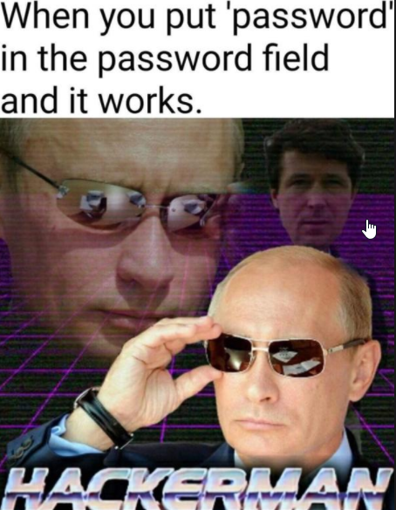
Attacking Active Directory
Lateral Movement
Moving Laterally Techniques
Psexec
Netsh
PS Remoting
WMI
Pass-the-Hash
Overpass-the-Hash
Pass-the-ticket
Golden Tickets
Token Impersonation
Skeleton Key
Silver Tickets
RDP
Unauthed VNC
@h3xg4m3s

Slide 32

Attacking Active Directory
Pass the hash sidenote
Moving Laterally Techniques
Psexec
Netsh
PS Remoting
WMI
Pass-the-Hash
Overpass-the-Hash
Pass-the-ticket
Golden Tickets
Token Impersonation
Skeleton Key
Silver Tickets
RDP
Unauthed VNC
But.. But.. MSFT Fixed pass the hash back in 2014 see KB2871997
@h3xg4m3s

Slide 33
Attacking Active Directory
Pass the hash sidenote
“Accounts that are members of the localgroup ‘Administrators’ are no longer able to execute code with WMI or PSEXEC”
Well…….
Except for the RID 500 built-in Administrator account, even if it’s renamed.
AND
Domain accounts that are granted administrative privileges over a machine can still pass-the-hash.
http://www.harmj0y.net/blog/penetesting/pass-the-hash-is-dead-long-live-pass-the-hash/
@h3xg4m3s

Slide 34
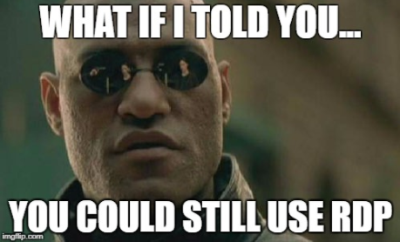
Attacking Active Directory
Up to date environment
Default Administrator Account Disabled
Obtained creds for a local admin user from a different box
If you can crack the hash or obtain the plaintext creds (mimikatz?)
you can still RDP into the box
http://www.harmj0y.net/blog/penetesting/pass-the-hash-is-dead-long-live-pass-the-hash/
@h3xg4m3s

Slide 35
Attacking Active Directory
Back to Theory
Win!
Yes
Start
Obtain Credentials
High Privilege User?
Identify Access
(Spread)
Migrate to New Host
No
@h3xg4m3s

Slide 36
Attacking Active Directory
Rinse and Repeat
Win!
Yes
Start
Obtain Credentials
High Privilege User?
Identify Access
(Spread)
Migrate to New Host
No
@h3xg4m3s

Slide 37
Attacking Active Directory
Rinse and Repeat
Win!
Yes
Start
Obtain Credentials
High Privilege User?
Identify Access
(Spread)
Migrate to New Host
No
@h3xg4m3s

Slide 38
Attacking Active Directory
Rinse and Repeat
Win!
Yes
Start
Obtain Credentials
High Privilege User?
Identify Access
(Spread)
Migrate to New Host
No
@h3xg4m3s

Slide 39
Attacking Active Directory
Rinse and Repeat
Win!
Yes
Start
Obtain Credentials
High Privilege User?
Identify Access
(Spread)
Migrate to New Host
No
@h3xg4m3s

Slide 40
Attacking Active Directory
Back to Theory
Bob
@h3xg4m3s

Slide 41

Attacking Active Directory
Attack Path
Bob
Session on
Session on
@h3xg4m3s

Slide 42
Attacking Active Directory
Attack Path
Bob
Session on
Session on
Alice
Session on
Session on
John
Session on
Joe
@h3xg4m3s

Slide 43
Attacking Active Directory
Attack Path
Bob
Session on
Session on
Alice
Session on
Session on
John
Session on
Joe
Session on
@h3xg4m3s

Slide 44
Attacking Active Directory
Attack Path
Bob
Session on
Session on
Alice
Session on
Session on
John
Session on
Joe
Session on
Mary
Session on
@h3xg4m3s

Slide 45
Attacking Active Directory
Attack Path
Bob
Session on
Session on
Alice
Session on
Session on
SqlAdmins
John
Member of
Session on
Joe
Session on
Mary
Session on
@h3xg4m3s

Slide 46
Attacking Active Directory
Attack Path
Bob
Session on
Session on
Alice
Session on
Session on
SqlAdmins
John
Member of
Session on
Can Access
Joe
Session on
Mary
Can Access
Session on
@h3xg4m3s

Slide 47
Attacking Active Directory
Attack Path
Bob
Session on
Session on
Alice
Session on
Session on
SqlAdmins
John
Member of
Session on
Can Access
Joe
Session on
Mary
DA Steve
Can Access
Session on
Session on
@h3xg4m3s

Slide 48
Attacking Active Directory
Finally have High Privilege?!!
Win!
Yes
Start
Obtain Credentials
High Privilege User?
Identify Access
(Spread)
Migrate to New Host
No
@h3xg4m3s

Slide 49
Attacking Active Directory
WIN
Win!
Yes
Start
Obtain Credentials
High Privilege User?
Identify Access
(Spread)
Migrate to New Host
No
@h3xg4m3s

Slide 50
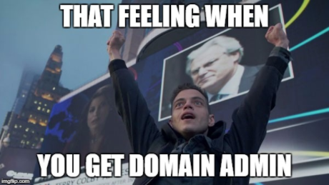
Attacking Active Directory
@h3xg4m3s

Slide 51
Attacking Active Directory
Domain Admin
Do the hashdance
DCSync
Hashdump the DC
Volume Shadow Copy
ntdsxtract https://github.com/csababarta/ntdsxtract
Never Leaving
Golden Tickets
(lesser) Silver Tickets
@h3xg4m3s

Slide 52
Attacking Active Directory
You’re not done!
What is important?
What do they value?
Enterprise Admin?
*Nix Environments?
@h3xg4m3s

Slide 53
Attacking Active Directory
@h3xg4m3s

Slide 54
Attacking Active Directory
Toolz
PowershellEmpire https://github.com/EmpireProject/Empire
Metasploit https://www.metasploit.com/
CrackMapExec https://github.com/byt3bl33d3r/CrackMapExec
Responder https://github.com/lgandx/Responder
Impacket https://github.com/CoreSecurity/impacket
PowerSploit https://github.com/PowerShellMafia/PowerSploit
Bloodhound https://github.com/BloodHoundAD/BloodHound
Sharphound https://github.com/BloodHoundAD/SharpHound
mimikatz https://github.com/gentilkiwi/mimikatz/
@h3xg4m3s

Slide 55

Attacking Active Directory
Bloodhound / Sharphound
BloodHound is developed by @_wald0, @CptJesus, and @harmj0y.
Notes:
“BloodHound is a single page Javascript web application, built on top of Linkurious, compiled with Electron, with a Neo4j database fed by a PowerShell ingestor C# ingester.”

Slide 56
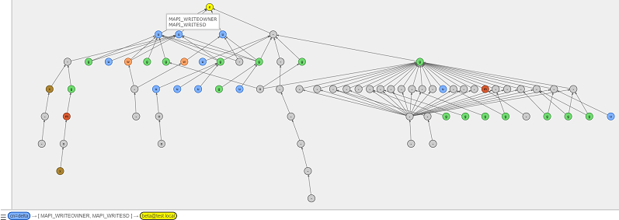
Attacking Active Directory
AD-Control-Paths
Latest AD-Control-Paths release “Who Can Read the CEO’s Emails Edition”
*Based off AD-Control-Paths By Lucas Bouillot and Emmanuel Gras*
https://github.com/ANSSI-FR/AD-control-path

Slide 57
Attacking Active Directory
Offensive AND Defensive
Fantastic tools for both Red and Blue teams!
Quickly identify ‘control relations’ between objects in Active Directory
Highly complex attack paths visualized in graphs
@h3xg4m3s

Slide 58
Attacking Active Directory
Fast
Fantastic tools for both Red and Blue teams!
Quickly identify ‘control relations’ between objects in Active Directory
Highly complex attack paths visualized in graphs
@h3xg4m3s

Slide 59

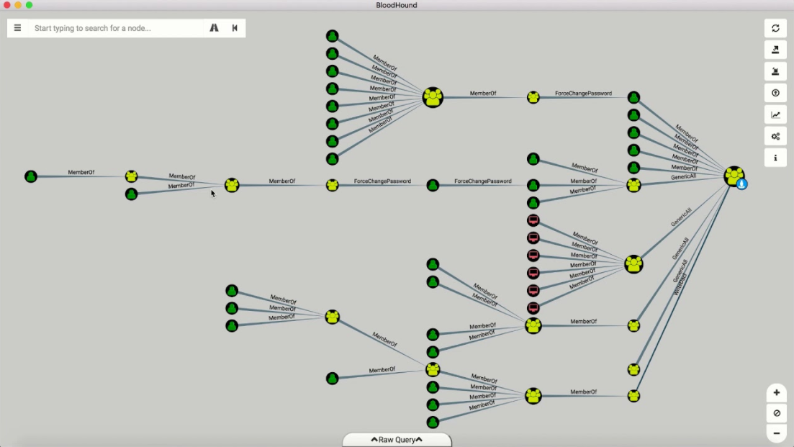
Bloodhound
Bloodhound / Sharphound

Slide 60
Attacking Active Directory
Graphs on Fleek
Fantastic tools for both Red and Blue teams!
Quickly identify ‘control relations’ between objects in Active Directory
Highly complex attack paths visualized in graphs
@h3xg4m3s

Slide 61
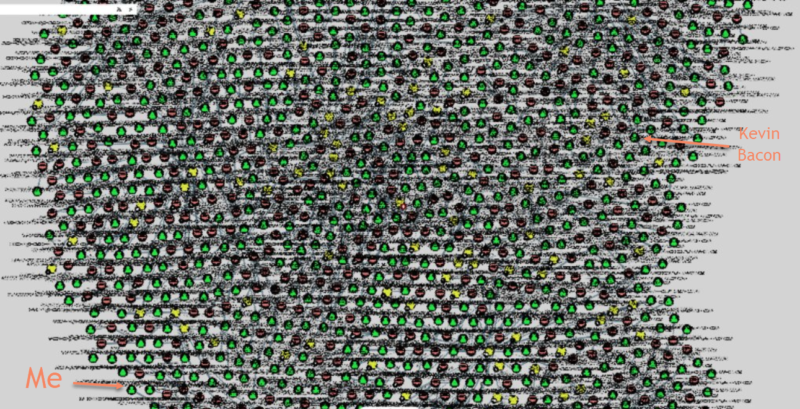
Six Degrees of Separation
Bloodhound / Sharphound

Slide 62
Attacking Active Directory
Setup – Kali Linux
Install Bloodhound
Start the neo4j server
Authenticate to the provided sample graph database at bolt://localhost:7687. The default username is "neo4j", and the password is " neo4j ".
In a different console window, start bloodhound.
https://github.com/BloodHoundAD/BloodHound/wiki/Getting-started

